Slide 1




Introduction to Databases
How do RDBMS work?
Intro to
DB
SoftUni Team
Technical Trainers
Software University
http://softuni.bg

Slide 2

Table of Contents
Data Management
Database Engine
Table Relationships
Programmability

Slide 3
Questions
sli.do #CSharpDB

Slide 4

Data Management
When Do We Need a Database?

Slide 5
Storage vs. Management
SALES RECEIPT
Date: 07/16/2016
Order#: [00315]
Customer: David Rivers
Product: Oil Pump
S/N: OP147-0623
Unit Price: 69.90
Qty: 1
Total: 69.90
00315 – 07/16/2016
David Rivers
Oil Pump (OP147-0623)
1 x 69.90

Slide 6
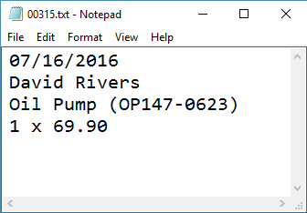
Storage vs. Management

Slide 7

Storage vs. Management (2)
Storing data is not the primary reason to use a Database
Flat storage eventually runs into issues with
Size
Ease of updating
Accuracy
Security
Redundancy
Importance

Slide 8
Databases and RDBMS
A database is an organized collection of information
It imposes rules on the contained data
Relational storage first proposed by Edgar Codd in 1970
A Relational Data Base Management System provides tools to manage the database
It parses requests from the user and takes the appropriate action
The user doesn't have direct access to the stored data

Slide 9


Database Engine

Slide 10





Database Engine Flow
SQL Server uses the Client-Server Model
Clients
Query
Engine
Access
Database
Data
Data

Slide 11
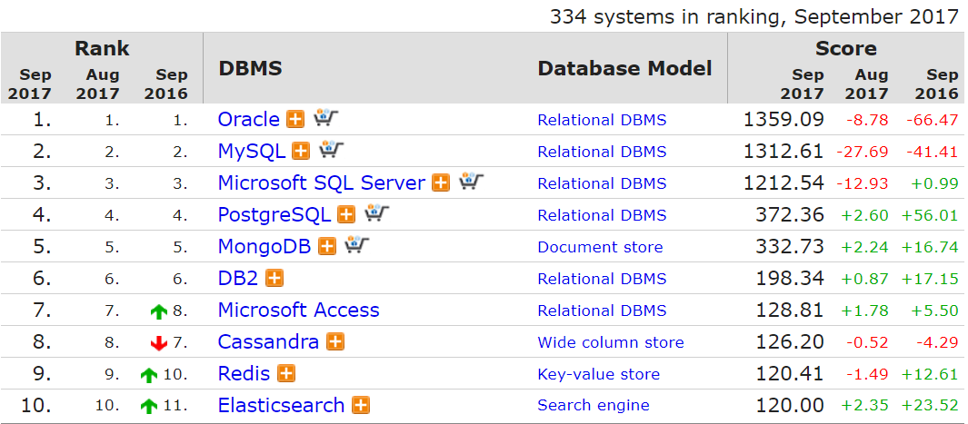
Top Database Engines
Source: http://db-engines.com/en/ranking

Slide 12


Download Clients & Servers
Download SQL Server Express Edition from Microsoft
The package includes SQL Server Management Studio
https://www.microsoft.com/en-us/sql-server/sql-server-downloads

Slide 13
SQL Server Architecture
Logical Storage
Instance
Database
Schema
Table
Physical Storage
Data files and Log files
Data pages
Instance
Database
Database
Schema
Table
Table
Table
Database
Schema
Data
Logs
☰
☰
☰
☰
☰
☰
☰
☰

Slide 14
Database Table Elements
The table is the main building block of any database
Each row is called a record or entity
Columns (fields) define the type of data they contain
Column
CustomerID | FirstName | Birthdate | CityID
1 | Brigitte | 03/12/1975 | 101
2 | August | 27/05/1968 | 102
3 | Benjamin | 15/10/1988 | 103
4 | Denis | 07/01/1993 | 104
Row
Cell
Notes:
The table is the main unit of data storage. It has rows, columns and cells. Cells contain stored data. Each column has a data type. Types can be VARCHAR(String), INT, DATE etc.

Slide 15
Structured Query Language
To communicate with the Engine we use SQL
Declarative language
Logically divided in four sections
Data Definition – describe the structure of our data
Data Manipulation – store and retrieve data
Data Control – define who can access the data
Transaction Control – bundle operations and allow rollback

Slide 16
Engine’s Behavior
Worker
Worker
Worker
THREADPOOL
Worker
EXECUTION
FREE THREAD
Parsing Compilation Optimization
Query Execution
Task
Plan Cache
Data Cache
CACHE
RESULTS
Task
Task
Database
QUERIES
Network
Network
Notes:
Databases are Client-Server platforms. Whenever the client sends a request it is received by the server through TCP/IP protocol. Requests create tasks which are handled by the thread pool of the database. Threads are in status idle and wait until a task appears. When a task shows up the execution begins. Firstly, the engine creates the execution plan. It says how the query is going to be executed. If there is an existing plan for the query it is used from the cache and no new execution plan generation happens. On the next step, the query checks whether it is in the data cache. It can appear in the data cache if it has been previously executed . If no data is found in the data cache then the data is retrieved from the database itself. Finally, the results are returned through TCP/IP to the client and the thread is released to idle state.

Slide 17
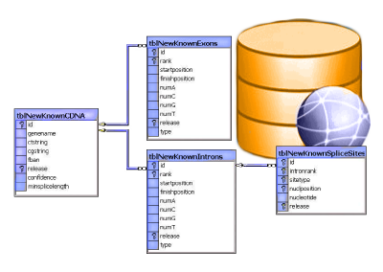
Table Relationships

Slide 18
Why Split Related Data?
Empty records
First | Last | Registered | Email
David | Rivers | 05/02/2016 | drivers@mail.cx
Sarah | Thorne | 07/17/2016 | sarah@mail.cx
Michael | Walters | 11/23/2015 | walters_michael@mail.cx
Email2
david@homedomain.cx
NULL
NULL
Redundant information
OrderID | Date | Customer | Product | S/N | Price
00315 | 07/16/2016 | David Rivers | Oil Pump | OP147-0623 | 69.90
00315 | 07/16/2016 | David Rivers | Accessory Belt | AB544-1648 | 149.99
00316 | 07/17/2016 | Sarah Thorne | Wiper Fluid | WF000-0001 | 99.90
00317 | 07/18/2016 | Michael Walters | Oil Pump | OP147-0623 | 69.90

Slide 19
Related Tables
We split the data and introduce relationships between the tables to avoid repeating information
The connection is established via a Foreign Key in one table pointing to the Primary Key in another
UserID | First | Last | Registered
203 | David | Rivers | 05/02/2016
204 | Sarah | Thorne | 07/17/2016
205 | Michael | Walters | 11/23/2015
UserID | Email
203 | drivers@mail.cx
204 | sarah@mail.cx
203 | david@homedomain.cx
205 | walters_michael@mail.cx
Primary Key
Foreign Key

Slide 20
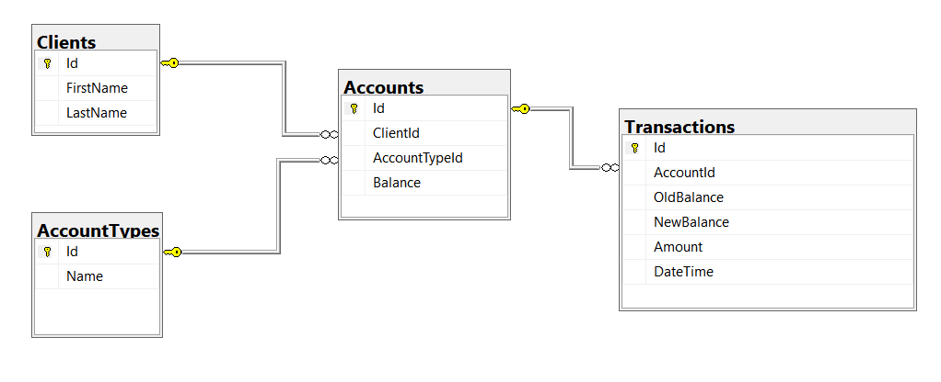
Relational Diagrams
Helps the client navigate the schema
Explaining relations between tables:

Slide 21
Programmability
Begin
?
?
Customizing Database Behavior

Slide 22
Indices
Indices make data lookup faster
Clustered – bound to the primary key, physically sorts data
Non-Clustered – can be any field, references the clustered index
Structured as an ordered tree
Keys
Index
0-99
100-199
200-299
Range 1
Range 2
Range 3
Data
Links
☰
☰
☰
☰
☰
☰
☰
☰
☰
☰
☰
☰
☰
☰

Slide 23
Views
Views are prepared queries for displaying sections of our data
Evaluated at run time – they do not increase performance
CREATE VIEW v_EmployeeNames AS
SELECT [EmployeeID], [FirstName] ,[LastName]
FROM [SoftUni].[dbo].[Employees]
SELECT * FROM v_EmployeeNames
Notes:
Views are objects that show portion of the data. For example, we may show only 3 column even though the table has 9.

Slide 24
Procedures, Functions and Triggers
A database can further be customized with reusable code
Procedures – carry out a predetermined action
E.g. calculate and store the weekly revenue based on recorded sales in the database
Functions – receive parameters and return a result
E.g. get the age of a person using their birthdate and current date
Triggers – watch for activity in the database and react to it
E.g. when a record is deleted, write it to an archive

Slide 25
Procedures
CREATE PROCEDURE p_LoadEmployees AS
BEGIN
SELECT [EmployeeID]
,[FirstName]
,[LastName]
,[Name] AS [DepartmentName]
INTO [Test].[dbo].[EmployeeDepartments]
FROM [SoftUni].[dbo].[Employees] AS e
LEFT OUTER JOIN [SoftUni].[dbo].[Departments] AS d
ON e.DepartmentID = d.DepartentID
END
EXEC p_LoadEmployees

Slide 26
Functions
CREATE FUNCTION f_GetAge (@Birthday date)
RETURNS int
AS
BEGIN
DECLARE @Result int;
SET @Result = DATEDIFF(YYYY, @Birthday, GETDATE());
RETURN @Result
END
SELECT [dbo].[f_GetAge]('2004/12/26')
Notes:
Functions resemble return methods in programming. They execute some logic and return a result of some data type.

Slide 27
Triggers
CREATE TRIGGER t_DepartmentHistory ON [SoftUni].[dbo].[Departments]
FOR DELETE AS
BEGIN
DECLARE @DepartmentID int;
DECLARE @Name nvarchar(50);
DECLARE @ManagerID int;
SET @DepartmentID = (SELECT [DepartmentID] FROM DELETED);
SET @Name = (SELECT [Name] FROM DELETED);
SET @ManagerID = (SELECT [ManagerID] FROM DELETED);
INSERT INTO [SoftUni].[dbo].[DepartmentHistory]
([DepartmentID], [Name], [ManagerID])
VALUES (@DepartmentID, @Name, @ManagerID);
PRINT 'Department with ID ' + CAST(@DepartmentID AS varchar(50))
+ ' has been recorded';
END
Notes:
Triggers are procedures which are bound to a table. They track if an Insert, Update or Delete statements is executed and then they trigger some logic. For example, if you delete a record in a table the trigger will catch the event and may log the deleted record in another table.

Slide 28
Summary
RDBMS store and manage data
Table relations reduce repetition and complexity
Databases can be customized with functions and procedures

Slide 29







Introduction to Databases
https://softuni.bg/courses/databases-sqlsrv

Slide 30
License
This course (slides, examples, demos, videos, homework, etc.) is licensed under the "Creative Commons Attribution-NonCommercial-ShareAlike 4.0 International" license
Attribution: this work may contain portions from
"Databases" course by Telerik Academy under CC-BY-NC-SA license

Slide 31





Trainings @ Software University (SoftUni)
Software University – High-Quality Education, Profession and Job for Software Developers
softuni.bg
Software University Foundation
http://softuni.foundation/
Software University @ Facebook
facebook.com/SoftwareUniversity
Software University Forums
forum.softuni.bg

